Slide 1
NORMAL DISTRIBUTION
NAZMUL KADER CHOWDHURY

Slide 2
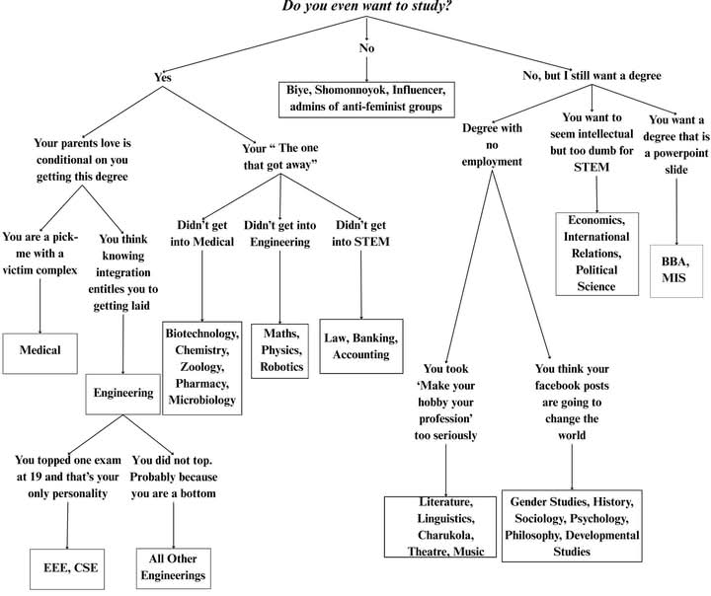

Slide 3
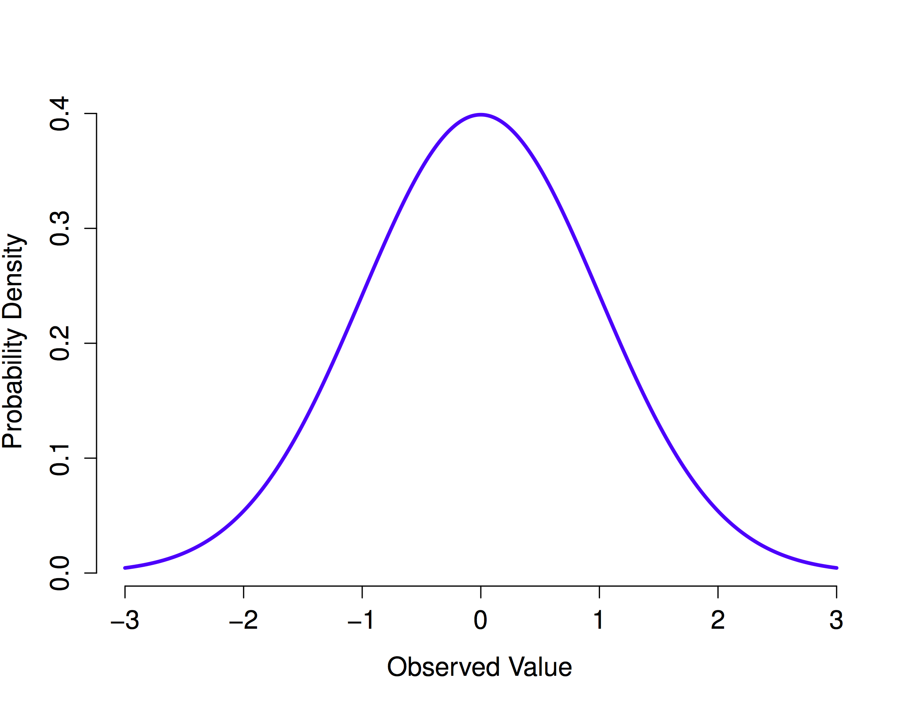

Slide 4
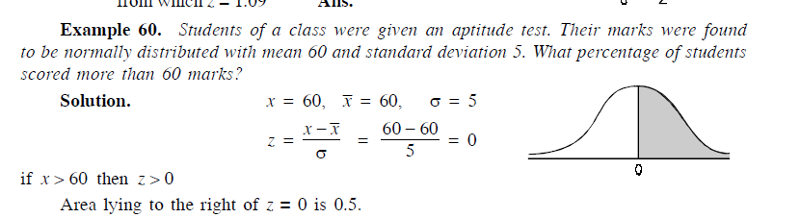
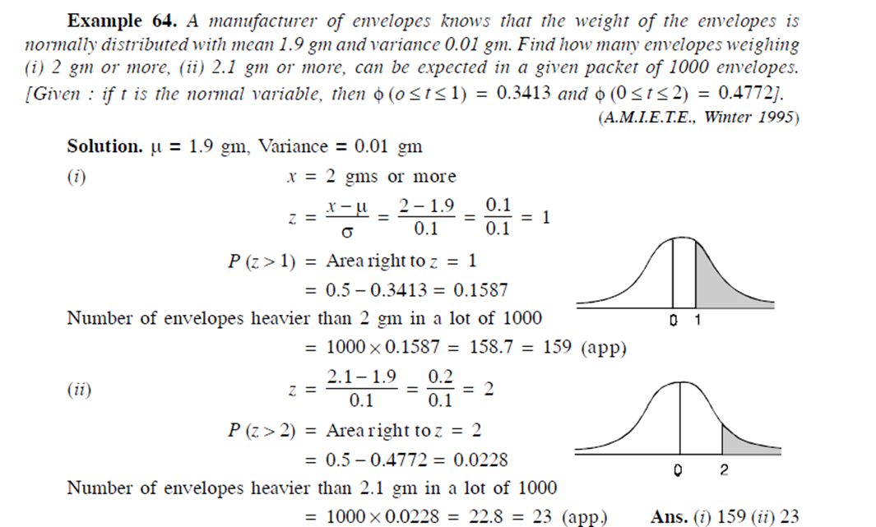

Slide 5
The length of life of an instrument produced by a machine has a normal distribution with a mean of 12 months and a standard deviation of 2 months. Find the probability that an instrument produced by this machine will last
a) less than 7 months.
b) between 7 and 12 months.
A large group of students took a test in Physics and the final grades have a mean of 70 and a standard deviation of 10. If we can approximate the distribution of these grades by a normal distribution, what percent of the students
a) scored higher than 80 ?
b) Should pass the test, grades greater 60 ?
c) Should fail the test, grades less 60 ?

Slide 6
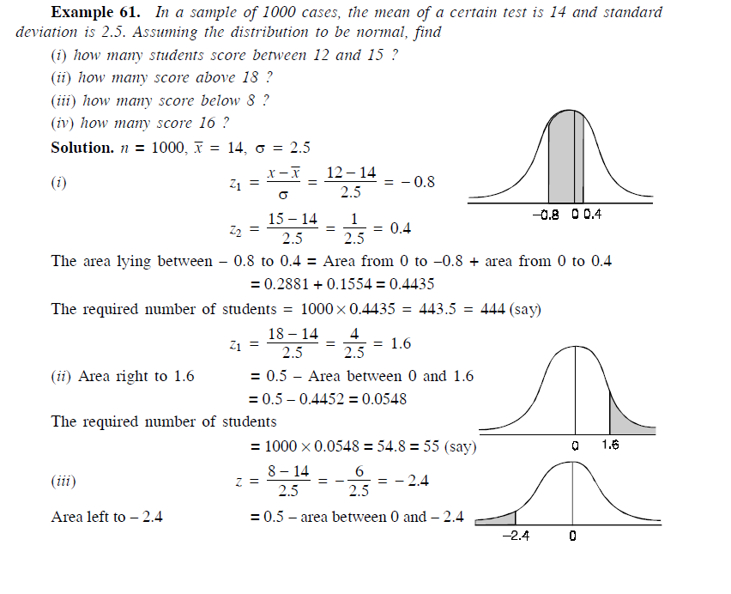

Slide 7
